Slide 1





BLE Explained
William Tan
Head / Technology Projects / SEIT

Slide 2
Scope
BLE Definition
Parallel Explanation
App Inventor Add-in
Arduino Add-in

Slide 3

BLE Definition
BLE – Bluetooth Low Energy
Part of Bluetooth 4.0
UUID – Universal Unique Identifier
GATT - GATT is an acronym for the Generic Attribute Profile, and it defines the way that two Bluetooth Low Energy devices transfer data back and forth using concepts called Services and Characteristics.
Taken from https://learn.adafruit.com/introduction-to-bluetooth-low-energy/gatt
Services & Characteristics are 16bit UUIDs define by Bluetooth Standard

Slide 4

Parallel Explanation: Local Library
Science
Technology
Engineering
Math
Shelf Sections =
Service UUIDs

Slide 5


Parallel Explanation: Local Library
Engineering
Service UUID
Book Index = Characteristic UUID

Slide 6

Parallel Explanation: Local Library
Service UUID
Data
Characteristic UUID

Slide 7
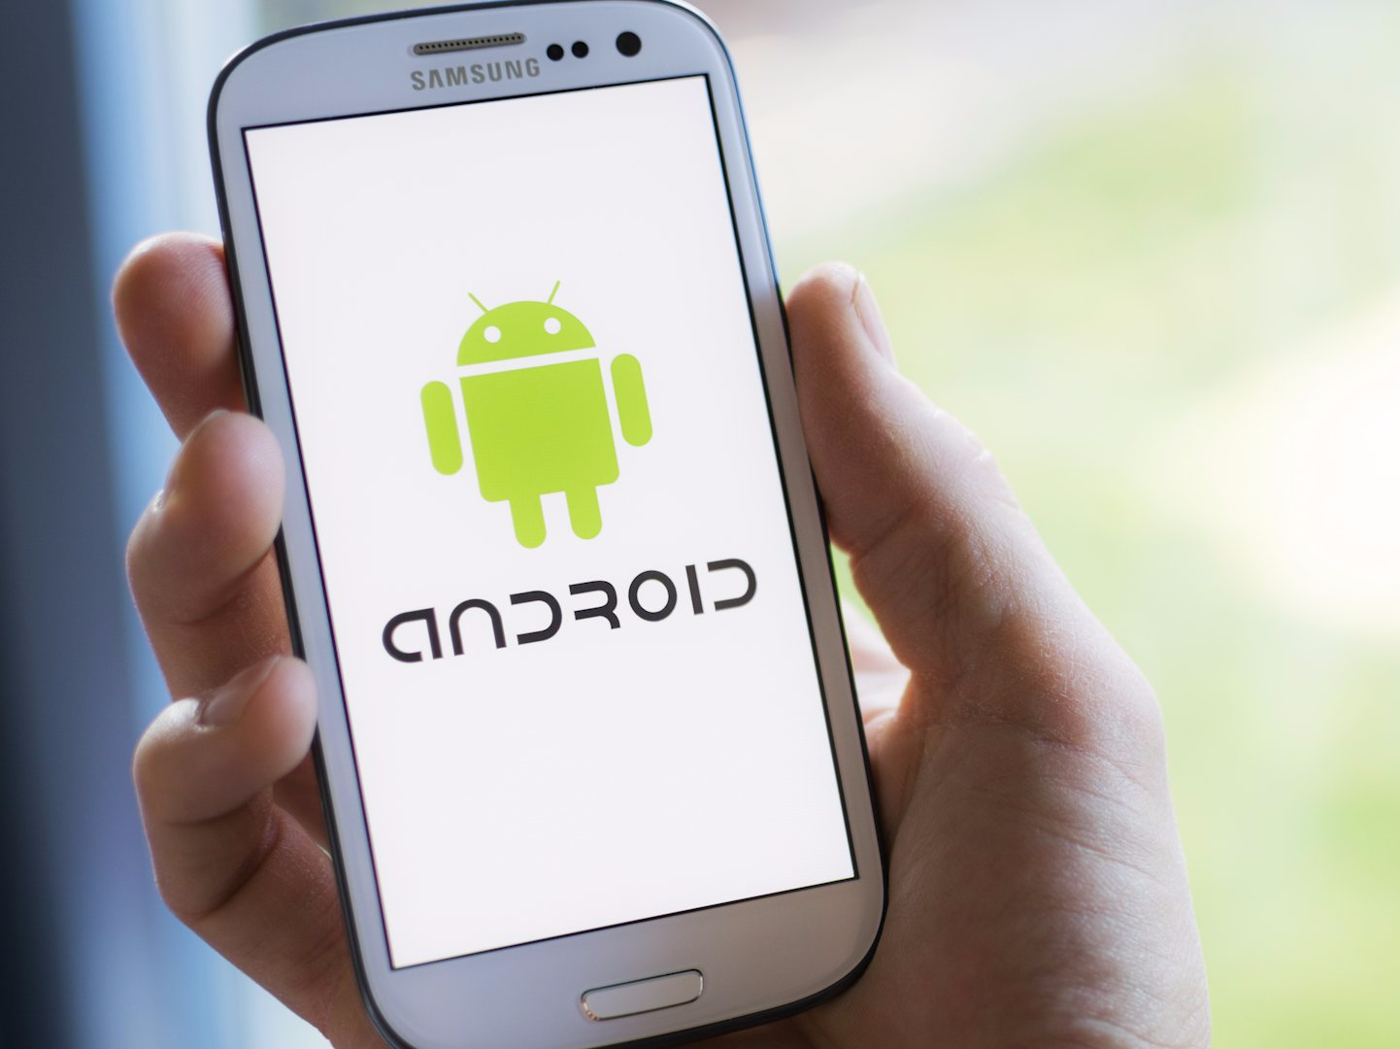
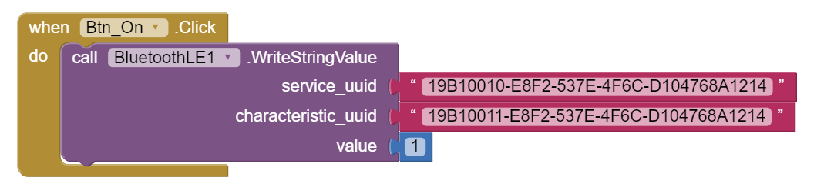
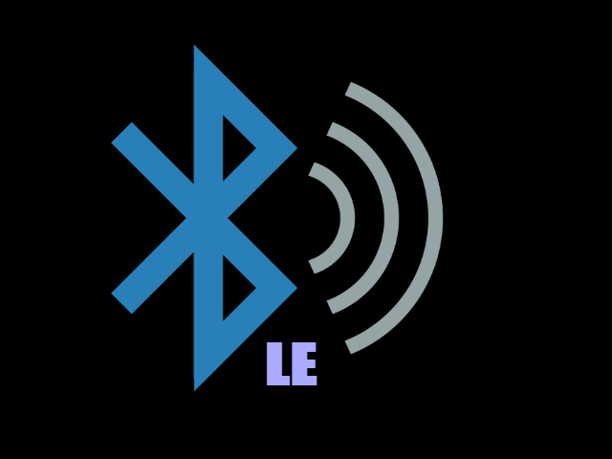
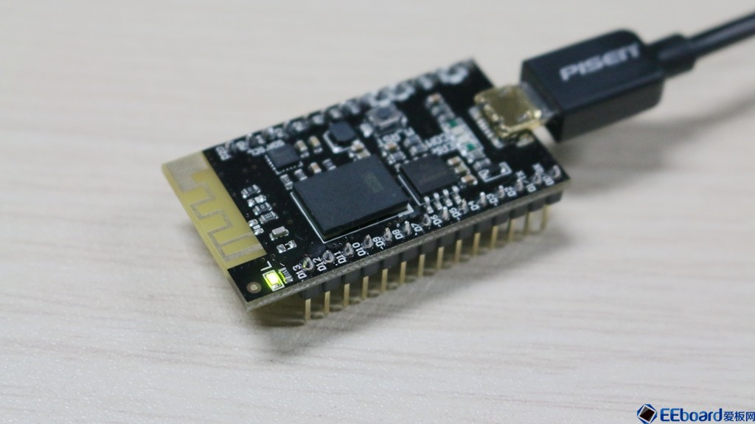

Day 1: BLE LED Blink Tutorials
Characteristic UUID
Generic GATT
Service UUID
Data
Arduino Program
On/Off LED
One Way Data Transfer

Slide 8
Day 2: BLE LED Blink Tutorial
Characteristic UUID
Generic GATT
Service UUID
Data
LED
2 Way Data Transfer
Arduino Program
Service UUID
Data
Sensor
Characteristic UUID
Battery GATT

Slide 9
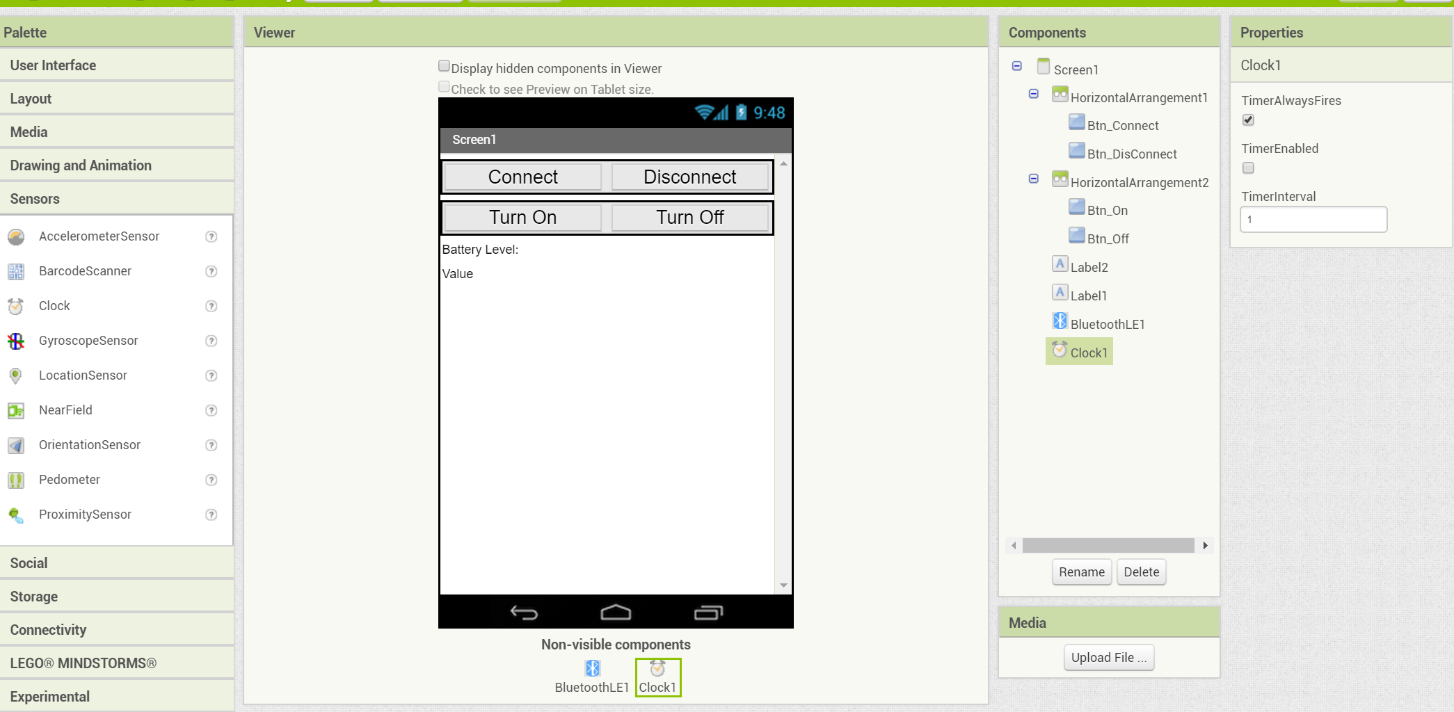
App Inventor Add-in

Slide 10
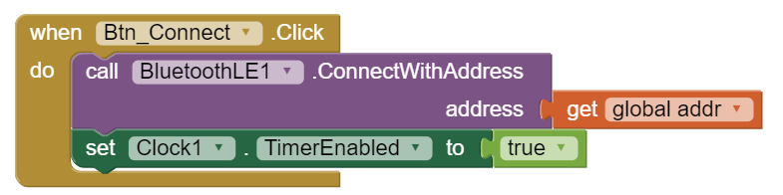
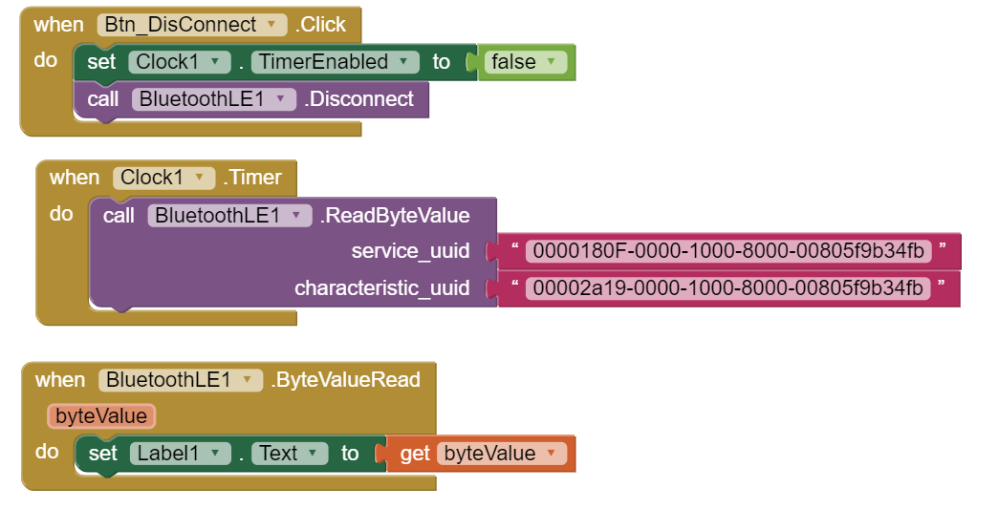
App Inventor Add-in

Slide 11
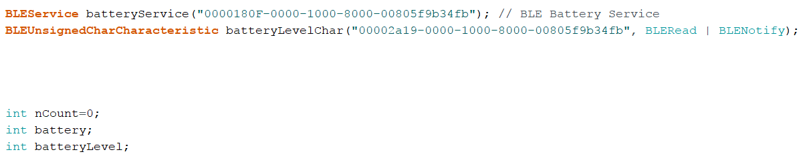
Arduino Add-in
At the Top, Global Definition and Variables Portion

Slide 12
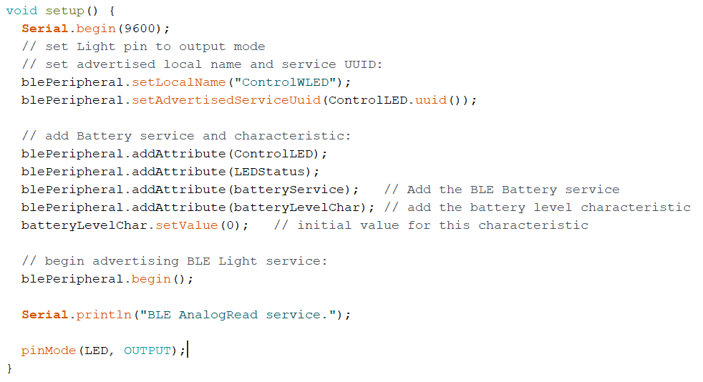
Arduino Add-in

Slide 13
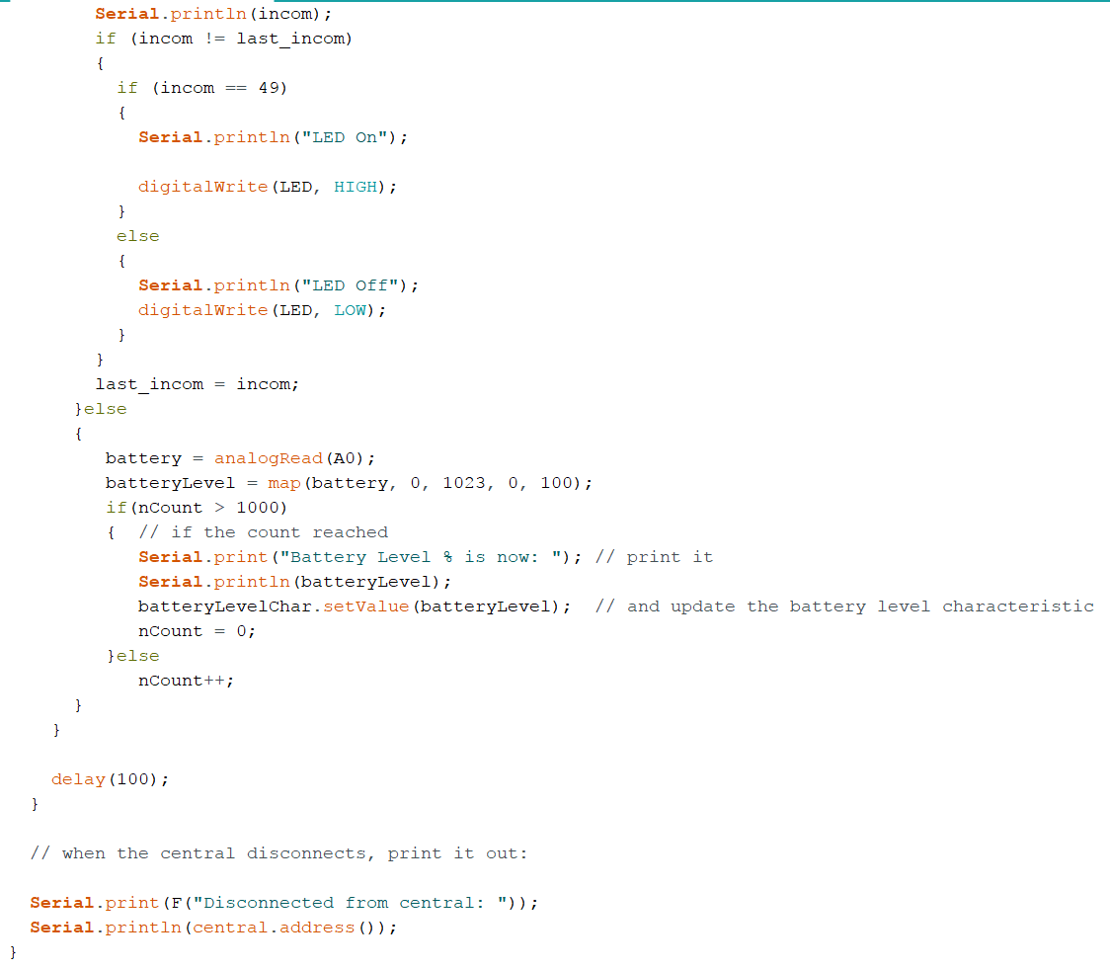
Arduino Add-in
At loop()

